Slide 1
YAFCEANs Collaborating with the Local Student Chapter
Partnership Best Practices between Young AFCEAs in NOVA & George Mason University (GMU)
By Kaitlin Bulavinetz, President, Young AFCEANs in Northern Virginia

Slide 2
Engagement Strategy
1. Mentoring student leadership
-Participating in Chapter Board meetings & events
2. Supporting students’ pursuits of internships & jobs
-Advocating for students with senior government leaders
-Resume review event prior to key career fair with 56 STEM students
3. Providing students with professional development opportunities
-Host event with government and industry STEM recruitment experts

Slide 3
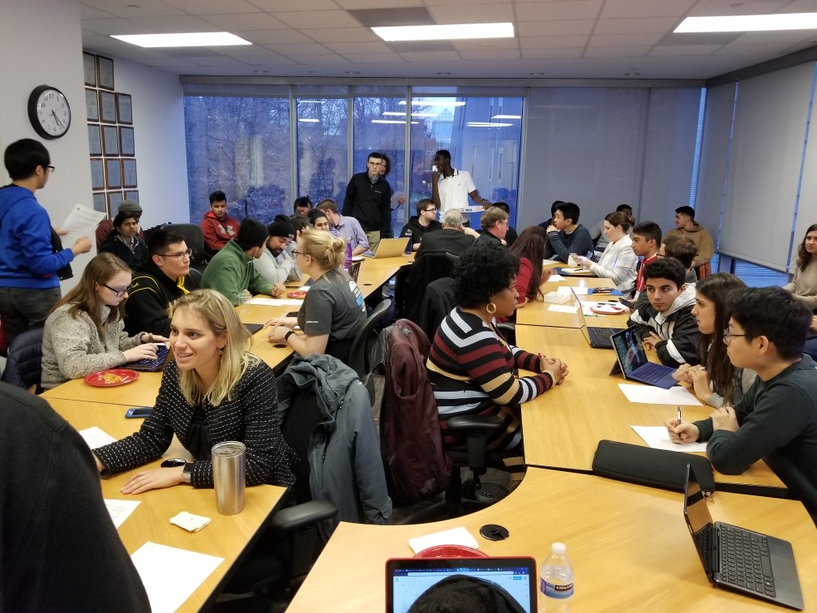
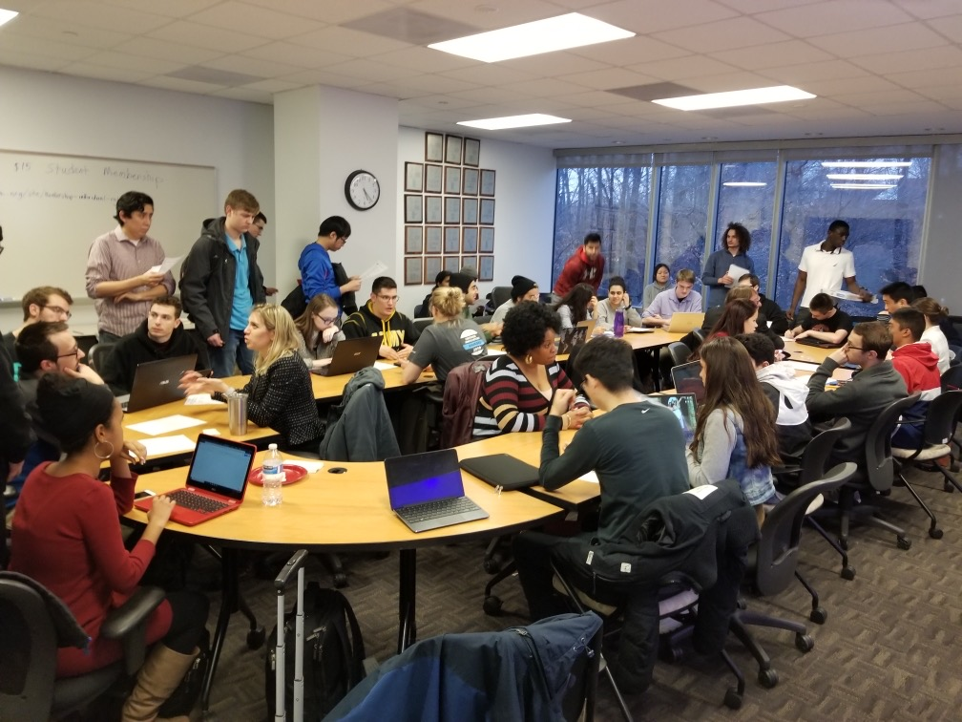
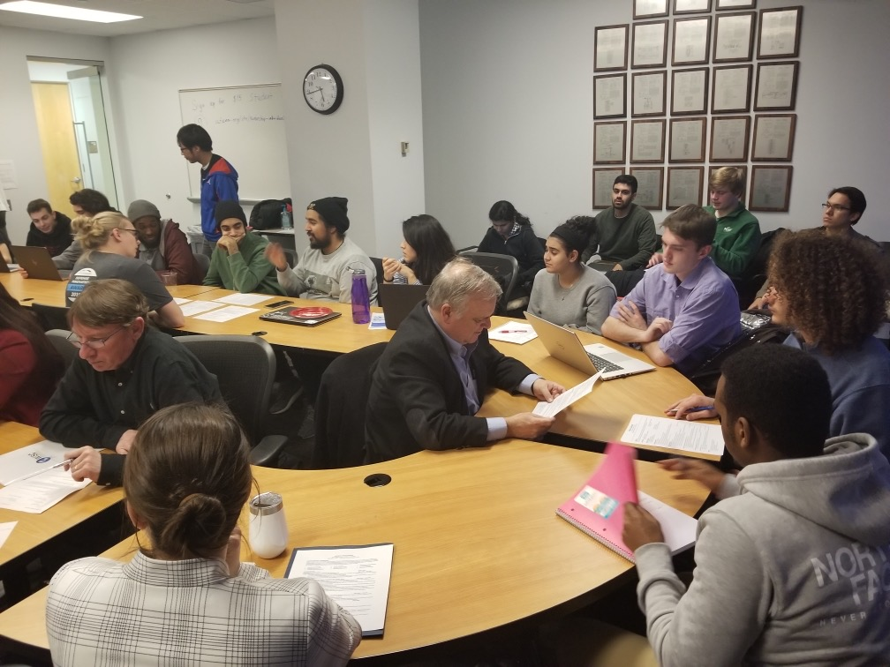
Resume Review Event

